Slide 1
International Style Architecture

Slide 2
Materials
Steel
Glass
Reinforced Concrete

Slide 3
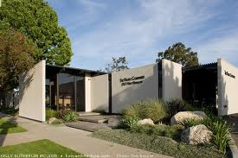
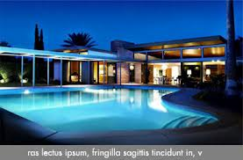
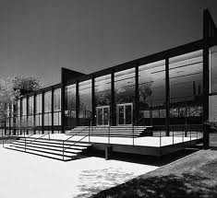
Features
Rectilinear

Slide 4
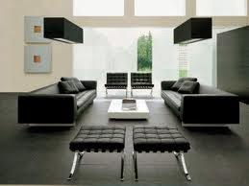
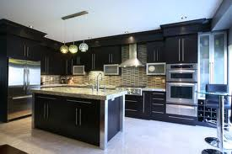
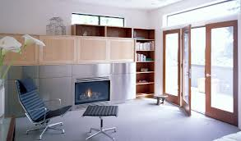
Feature
Very open

Slide 5
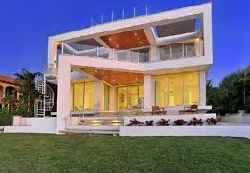
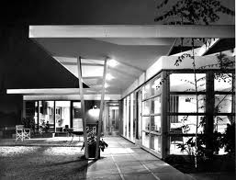
Feature
Lots of glass

Slide 6
Sources
http://www.google.com/url?sa=i&rct=j&q=international+style+architecture&source=images&cd=&cad=rja&docid=XDNuBXmh_G22-M&tbnid=dEjacirZfjb71M:&ved=0CAQQjB0&url=http%3A%2F%2Fpast.pacificstandardtime.org%2Fexhibitions%3Fid%3Dbreaking-ground-chinese-american-architects-in-los-angeles-1945-1980&ei=rQUBUtjOIPGCyAH7woHYAw&bvm=bv.50310824,d.aWc&psig=AFQjCNE1n0pbF1Vfr2s2OeXwp683DY6TPA&ust=1375884629577788

Slide 7
http://www.google.com/url?sa=i&rct=j&q=international+style+architecture&source=images&cd=&cad=rja&docid=eDL9h1G-Z5iykM&tbnid=SKYVH9x0baTtaM:&ved=0CAQQjB0&url=http%3A%2F%2Fwww.coop15blog.com%2Finternational-style-update%2F&ei=7AUBUqvgBqrMyQHNsIGoCA&bvm=bv.50310824,d.aWc&psig=AFQjCNE1n0pbF1Vfr2s2OeXwp683DY6TPA&ust=1375884629577788

Slide 8
http://www.google.com/url?sa=i&rct=j&q=international+style+architecture&source=images&cd=&cad=rja&docid=OiaNlLSirGaudM&tbnid=r706OLY-teSXXM:&ved=0CAQQjB0&url=http%3A%2F%2Fhollywoodhillshomes.com%2FThe%2520International%2520Style&ei=CgYBUur9IqfuyQGahoGQDg&bvm=bv.50310824,d.aWc&psig=AFQjCNE1n0pbF1Vfr2s2OeXwp683DY6TPA&ust=1375884629577788

Slide 9
http://www.google.com/url?sa=i&rct=j&q=international+style+architecture&source=images&cd=&cad=rja&docid=UM_ylY6WxV7okM&tbnid=Z7hI9Is0WEf9PM:&ved=0CAQQjB0&url=http%3A%2F%2Fwww.artjabber.com%2F2011%2F12%2Fsmud-headquarters-international-style-architecture-in-sacramento-ca%2F&ei=NQYBUsaHJqewyQH8-4GYDw&bvm=bv.50310824,d.aWc&psig=AFQjCNE1n0pbF1Vfr2s2OeXwp683DY6TPA&ust=1375884629577788

Slide 10
http://www.google.com/url?sa=i&rct=j&q=international+style+architecture&source=images&cd=&cad=rja&docid=Ni1FAn-2jAWBnM&tbnid=QXqI1-Eh0Rb4mM:&ved=0CAQQjB0&url=http%3A%2F%2Fdesignkuxnja.net%2Fkitchen-windows-design%2F&ei=sQYBUqabFYXYyQHVuIDoDg&bvm=bv.50310824,d.aWc&psig=AFQjCNE1n0pbF1Vfr2s2OeXwp683DY6TPA&ust=1375884629577788

Slide 11
http://www.google.com/url?sa=i&rct=j&q=international+style+architecture&source=images&cd=&cad=rja&docid=oLhfKTgBPSj7uM&tbnid=AjZQlEprzF3VlM:&ved=0CAQQjB0&url=http%3A%2F%2Fwww.ksmarchitecture.com%2Fportfolio%2F&ei=7AYBUp2gNqqgyAHS84HAAw&bvm=bv.50310824,d.aWc&psig=AFQjCNE1n0pbF1Vfr2s2OeXwp683DY6TPA&ust=1375884629577788

Slide 12
http://www.google.com/url?sa=i&rct=j&q=international+style+architecture&source=images&cd=&cad=rja&docid=VO0wFv77QzDYMM&tbnid=AT8LbSdvKAgENM:&ved=0CAQQjB0&url=http%3A%2F%2Fwww.cygnusrealestate.com%2Farchitecture.aspx&ei=VAYBUourFMrXyAHM1IDICg&bvm=bv.50310824,d.aWc&psig=AFQjCNE1n0pbF1Vfr2s2OeXwp683DY6TPA&ust=1375884629577788

Slide 13
http://www.google.com/url?sa=i&rct=j&q=international+style+architecture&source=images&cd=&cad=rja&docid=546GvW-jF_UYZM&tbnid=AdewfEym3gwiAM:&ved=0CAQQjB0&url=http%3A%2F%2Fmagivo.com%2Fmodern-interiors.html&ei=kgYBUs2_JavYyAHYxIGADw&bvm=bv.50310824,d.aWc&psig=AFQjCNE1n0pbF1Vfr2s2OeXwp683DY6TPA&ust=1375884629577788

Slide 14
http://www.merriam-webster.com/dictionary/international%20style

